Slide 1

PATHWAY TO SUSTAINABLE DEVELOPMENT
Harnessing AI for Global Food Security
Brian Kim
2025/12/12 @ NCHU
Global Master of Business Administration (GMBA)
Tunghai University

Slide 2
Warming Up
A good _____________ helps guide and support their team members to do their best work.
The company's main _____________ is to increase sales by 20% this year.
Managers must make important _____________ every day, such as choosing which project to start first.
When employees work together as a _____________, they can achieve more than working alone.
Good _____________ means speaking clearly and listening carefully to understand each other.

Slide 3
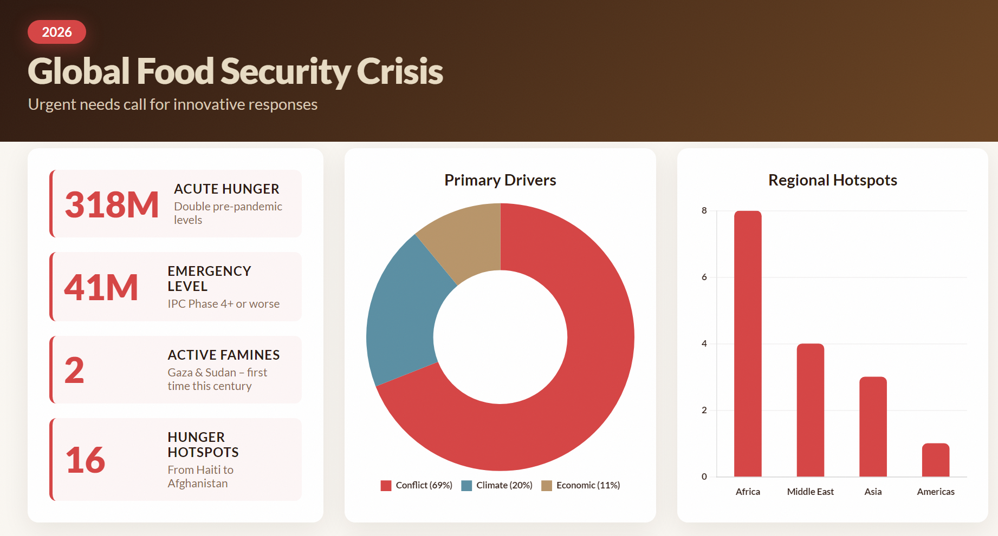
IPC: Integrated Food Security Phase Classification

Slide 4
The Global Imperative
2026: Urgent needs call for innovative responses
The 2026 Global Outlook paints a stark picture of global food insecurity but also highlights pathways for hope. An estimated 318 million people face acute hunger – double pre-pandemic levels – with 41 million at Emergency levels or worse (IPC Phase 4+). Two famines have been confirmed in Gaza and parts of Sudan, marking the first time this century famine has struck two countries simultaneously. Sixteen hunger hotspots, from Haiti and Mali to Afghanistan and Yemen, remain at high risk. Conflict drives 69 percent of hunger, while climate shocks – droughts, floods, and storms – compound the crisis. Syria’s crop production is down 60 percent, and Hurricane Melissa recently devastated Jamaica, Haiti, and Cuba.
Despite these challenges, the Outlook emphasizes solutions. WFP aims to assist 110 million people in 2026 with an operational requirement of US$13 billion. Innovation and partnerships are central to this effort: AI-powered tools like SCOUT optimize supply chains, saving millions, while digital cash transfers and anticipatory action protect lives before disasters strike – every dollar invested saves seven dollars in losses.

Slide 5
The Global Imperative
The 2026 Global Outlook
An estimated 318 million people face acute hunger: double pre-pandemic levels
41 million at Emergency levels or worse (IPC Phase 4+).
Two famines have been confirmed in Gaza and parts of Sudan
Sixteen hunger hotspots, from Haiti and Mali to Afghanistan and Yemen, remain at high risk.
Causes
Conflict drives 69 percent of hunger
Climate shocks – droughts, floods, and storms – compound the crisis.
Syria’s crop production is down 60 percent, and Hurricane Melissa recently devastated Jamaica, Haiti, and Cuba.

Slide 6
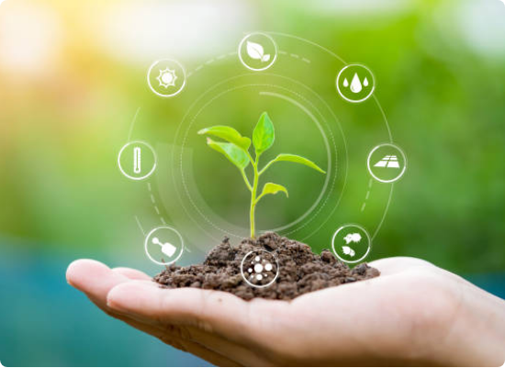
The Global Imperative
The Challenge: Feeding a growing global population while adhering to sustainable practices is one of the defining challenges of our time.
SDG 2: "Zero Hunger" aims to end hunger, achieve food security, and promote sustainable agriculture.
Key Constraints: Traditional farming is limited by arable land (Space) and growing seasons (Time).
The Question: How do we produce more with less?

Slide 7
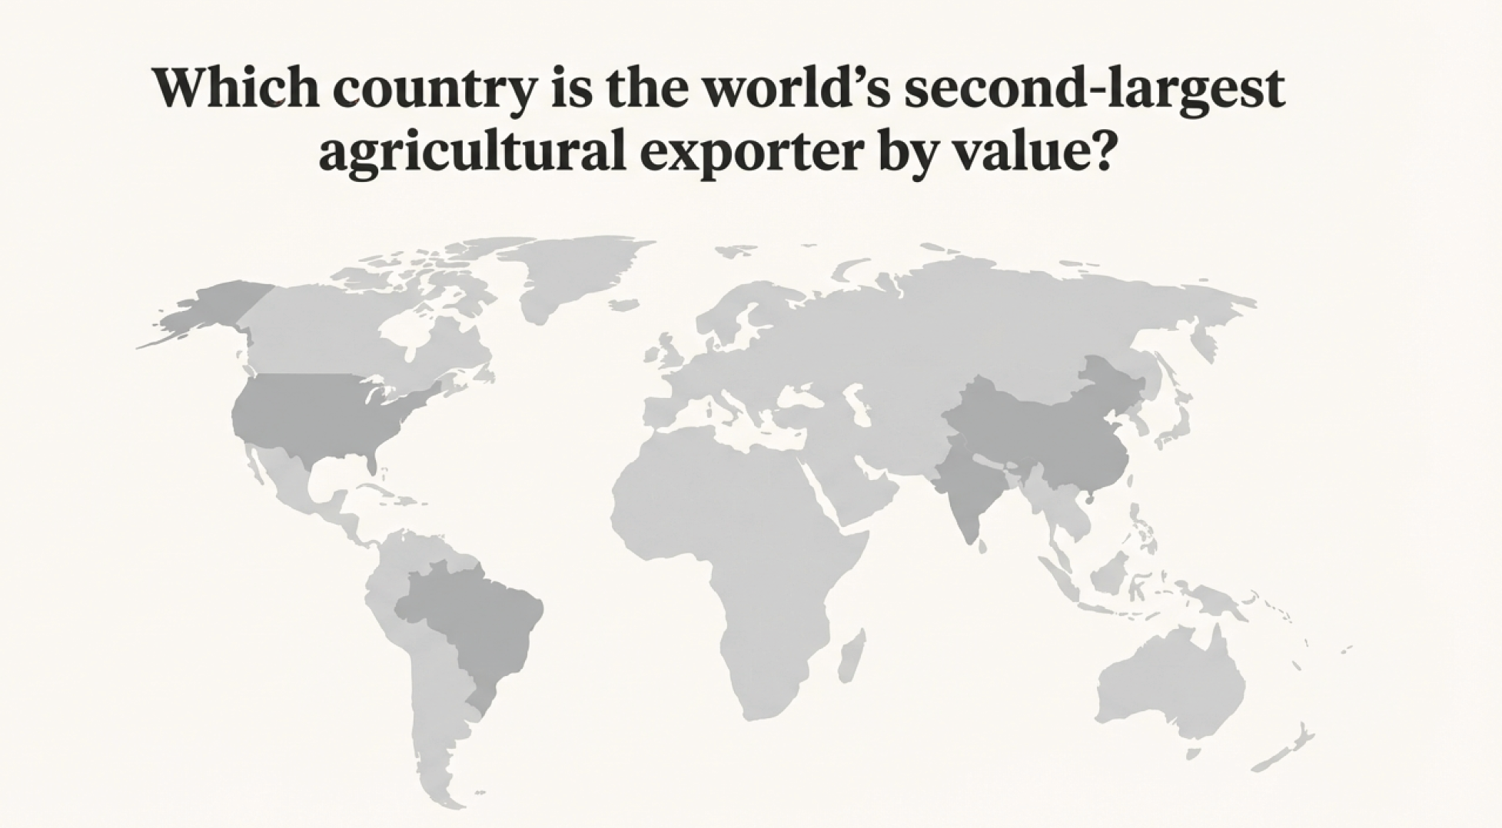

Slide 8
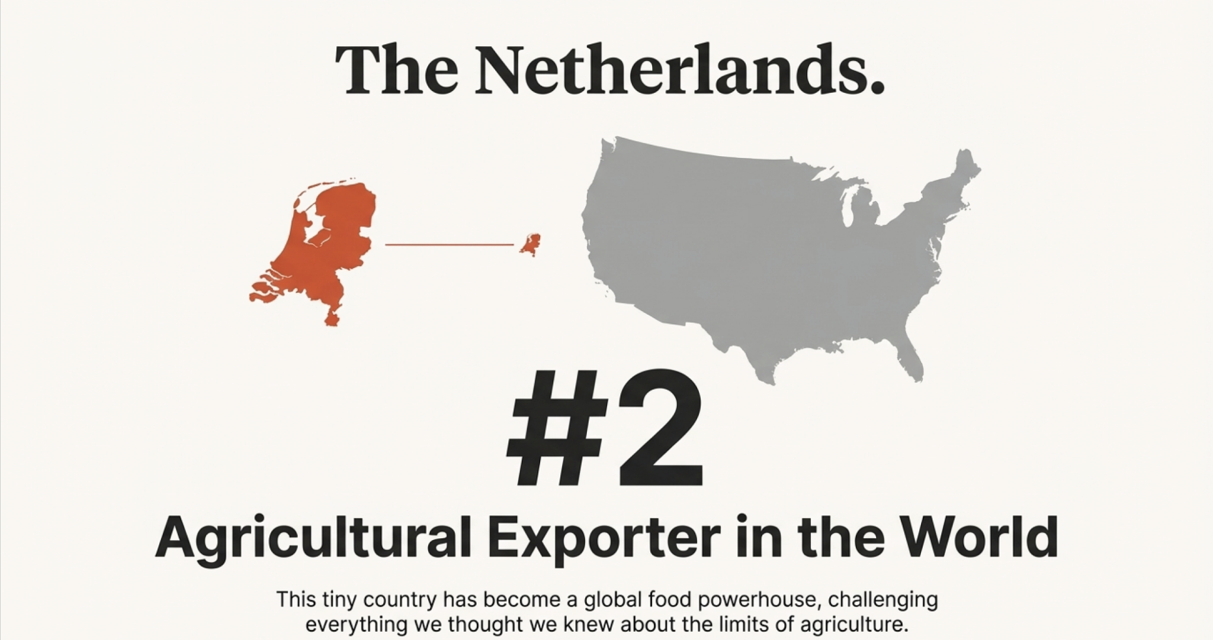

Slide 9
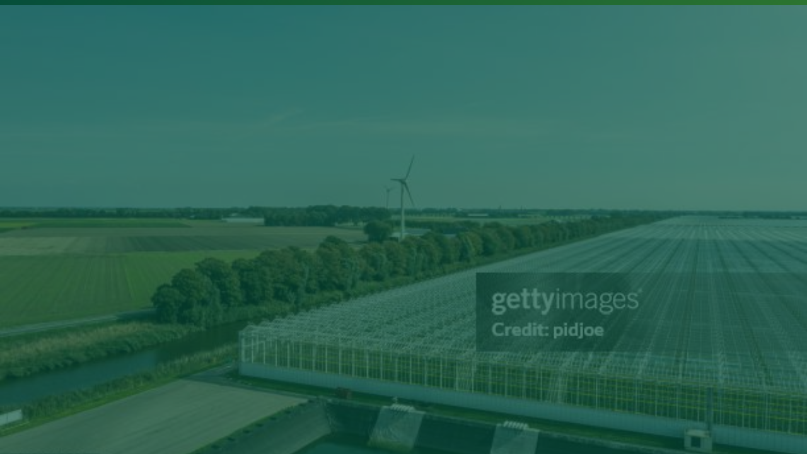
Module 1: What? The Netherlands Anomaly

Slide 10


Small Country, Massive Output
#2 Global Exporter
Overcoming Nature
Despite its small size, the Netherlands is the world's second-biggest agricultural exporter by value, trailing only the United States.
How does a tiny, densely populated nation feed the world? By refusing to accept natural limitations as absolute boundaries.
€95.6B+
•
High-density greenhouses
•
Precision farming techniques
•
Focus on high-value crops
Annual Agricultural Exports

Slide 11
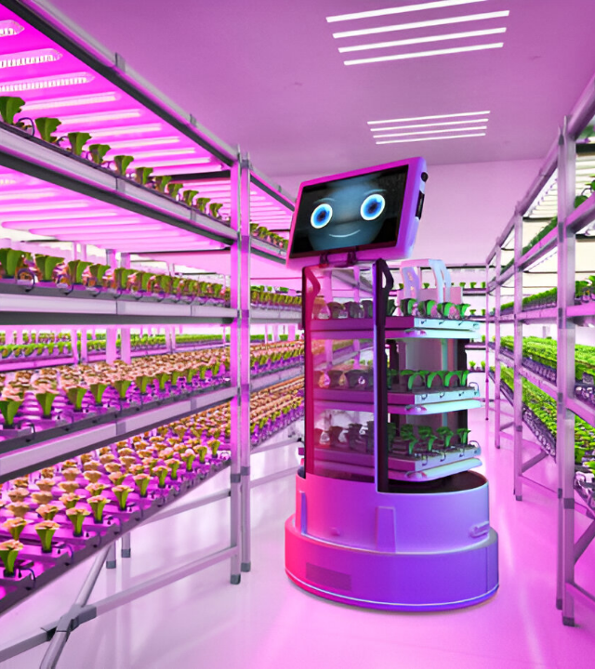
Conquering Space & Time
Traditionally, farming was bound by two factors:
Available land (Space) and seasons (Time).
Smart farming shatters these constraints.
Vertical Farming: Overcomes space limitations by stacking production layers, enabling high yields in urban centers.
Smart Greenhouses: Overcome time limitations by creating artificial climates, allowing for year-round production regardless of external weather.

Slide 12


Slide 13


Slide 14
"Farming is not limited by nature anymore.
It is only limited by idea and innovation."
THE NEW AGRICULTURAL MINDSET

Slide 15

Module 2: So What? Enter Artificial Intelligence

Slide 16






Accelerating Innovation
The Challenge
The AI Solution
The Result
Traditional agricultural research requires repeating experiments with different element combinations across many growing seasons.
AI can run thousands of simulations simultaneously, predicting outcomes without waiting for physical crop cycles.
Tremendously shortened development times for new crop varieties, pest control methods, and farming strategies.

Slide 17
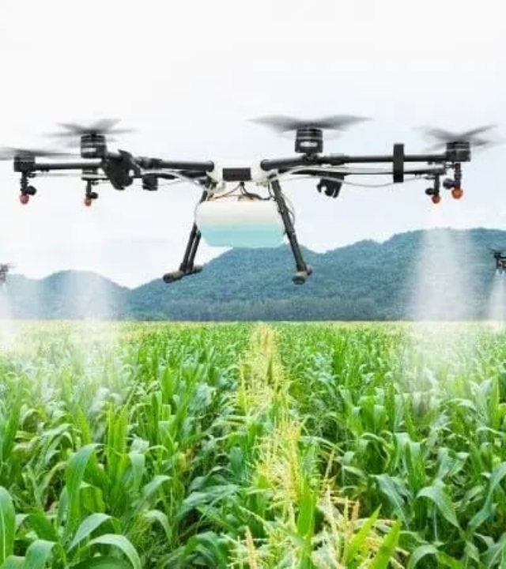
Case 1: Precision Cotton
The Problem: Blind application of pesticides is costly, labor-intensive, and harmful to the environment.
The AI Solution: Technologies like the "FlightSensor" (Georgia Tech) use machine learning to recognize the unique wingbeats of specific pests.
Impact: Farmers can apply treatment only where needed ("Predictive Pest Control"), significantly reducing chemical use and preserving ecosystems.

Slide 18
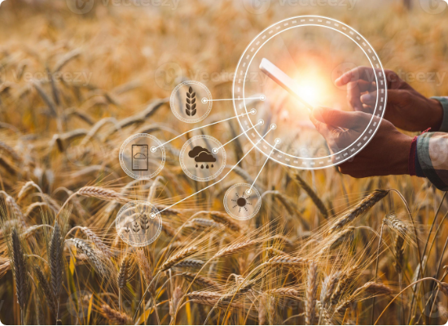
Reducing Costs & Labor
AI isn't just about robots; it's about actionable intelligence that saves money.
Agroview (UF): Uses drones and satellites to assess plant stress and count crops, reducing data collection costs by up to 90%.
ExtensionBot (OSU): An AI chatbot providing instant, research-based agricultural advice to farmers.
Precision Weed Sprayers: Distinguish between crops and weeds, drastically cutting herbicide expenses.

Slide 19

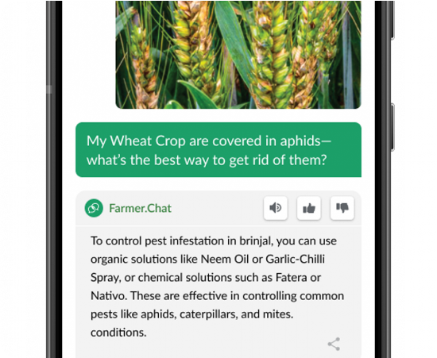
Case 2: Advisory via Farmer.chat
The Problem: Smallholders lack digital skills, face language barriers, and do not know which training content fits their specific crops and problems.
The Solution: Digital Green’s Farmer.chat is an AI chatbot accessed through WhatsApp/Telegram that understands questions in local languages and returns targeted training videos using generative
Impact: Farmers get immediate, localized advice while Digital Green builds rich, consent-based datasets on farmer challenges, improving future AI tools.

Slide 20
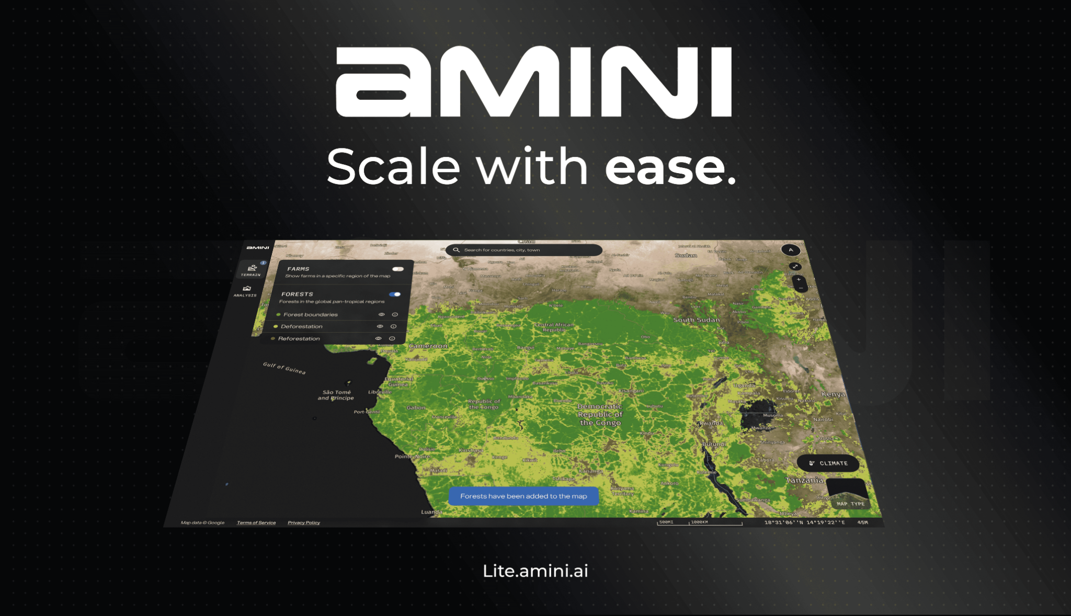
Case 3: Finance & Insurance via Amini
The Problem: Missing and fragmented environmental data makes it hard for farmers to optimize production and for banks/insurers to assess risk and design suitable financial products.
The Solution: Amini combines satellite, public, and private data, processes it with AI models, and sends insights to farmers via SMS/WhatsApp while offering dashboards to financial partners.
Impact: Actors like Aon and the African Development Bank can de-risk lending and create precise crop insurance, expanding access to finance for smallholders.

Slide 21
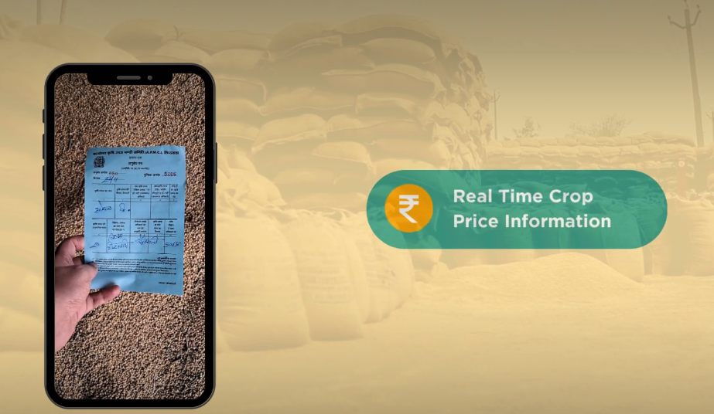
Case 4: Market Access via Gramhal
The Problem: Smallholders have weak bargaining power because they lack real-time, trustworthy price information across markets and value chains.
The Solution: Gramhal’s Bolbhav platform collects price data from sales receipts using computer vision AI to build a live price database shared back with farmers.
Impact: Farmers gain transparent, multi-market price information, strengthening negotiation power and enlarging their buyer pool while participating in a data cooperative.

Slide 22
Module 3: Now What?
New Economic Paradiam

Slide 23
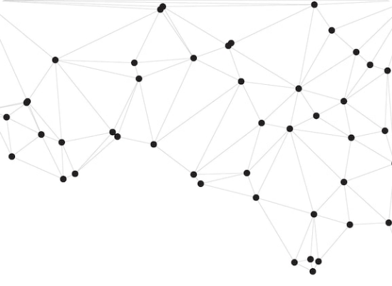
A New Economic Paradigm
From Scarcity to Motivation
Traditionally, economics dictates that "the richer get richer" because they own the resources.
AI flips this script. Lack of physical resources (land, machinery) is no longer a blockage—it is a motivation for innovation.
Just as digital platforms revolutionized service industries, AI allows agricultural value to be created through data and efficiency rather than just land ownership.

Slide 24






Value Without Assets
Uber
Airbnb
Future Ag
Built the world's largest taxi company without owning a single vehicle.
Built the world's largest hospitality business without owning a single hotel.
Building global food security through knowledge & algorithms rather than just acreage.

Slide 25

The Future is Here
We are moving from an era of resource-dependency to an era of intelligence-dependency. AI is the key to unlocking sustainable food security for all.

Slide 26
Questions?
Thank you for your attention.

Slide 27


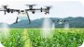



Image Sources
https://media.istockphoto.com/id/1282487121/photo/hands-holding-seedlings-modern-agriculture-with-technology-concept.jpg?s=612x612&w=0&k=20&c=KUxv0LI6y-5iiWrjNLiscqsgPbnAW1q5VPgXxYBYFF4=
Source: www.istockphoto.com
https://agritechdigest.com/wp-content/uploads/2024/06/7xm.xyz823674.jpg
Source: agritechdigest.com
https://www.escatec.com/hs-fs/hubfs/drone_spraying_agtech.webp?width=800&height=450&name=drone_spraying_agtech.webp
Source: www.escatec.com
https://static.vecteezy.com/system/resources/previews/012/337/341/large_2x/smart-farming-concept-farmer-with-technology-digital-tablet-on-background-of-wheat-field-professional-farmers-use-internet-of-things-iot-computers-system-to-manage-farms-agriculture-modern-idea-photo.jpg
Source: www.vecteezy.com
https://img.freepik.com/premium-vector/geometric-network-pattern-with-black-nodes-connecting-lines-white-background-representing-modern-digital-communication-technology-abstract-design_1282075-5188.jpg
Source: www.freepik.com
https://media.gettyimages.com/id/1427473357/photo/aerial-view-of-a-modern-agricultural-greenhouse-in-the-netherlands.jpg?s=612x612&w=gi&k=20&c=PnBJdhhpNZySneeC9LTNi58gKny2aLkLElRhZ2Telok=
Source: www.gettyimages.no

Slide 28

Image Sources
https://www.tenupsoft.com/images/blogs/drone-with-ai-overlay-scanning-crops-for-pest-detection-main-image.webp
Source: www.tenupsoft.com

